Slide 1
Vision-Assisted Industrial Robot
TEAM – 06
ARAADHANA.R(9925005014)
ABINAYA.S(9925005014)
AFIYA RIFTHA O A(9925005007)
KATHIRVEL C(9925005019)

Slide 2
introduction
Industrial robots are widely used for material handling, sorting, assembly and packaging.
Conventional robots generally work according to predefined positions and movements.
A vision system allows the robot to identify objects and determine their location.
Our project combines computer vision, STM32 embedded control and a mobile robotic platform.
The robot can move toward a target object and perform pick-and-place operations.

Slide 3
Problem statement
Problem:
Traditional automated handling systems may require fixed object positions or predefined paths.
Our proposed solution:
Detect the required object using a camera.
Determine its position in the working area.
Move the mobile robot toward the object.
Use a robotic arm and gripper to pick and place the object.
Reduce manual intervention.

Slide 4
Objectives
Develop a mobile vision-assisted industrial robot.
Use a camera for object detection.
Estimate the object’s position.
Map image coordinates to robot coordinates.
Control the mobile base using STM32.
Control the robotic arm and gripper.
Demonstrate automatic pick-and-place/sorting.

Slide 5
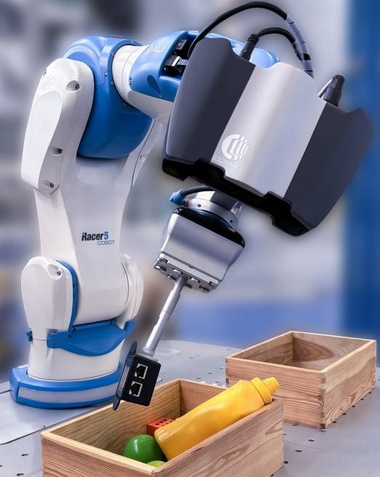
Existing System
Existing approaches:
Fixed robotic arms
Conveyor-based automation
Pre-programmed pick-and-place systems
Vision-guided industrial robots
Limitations:
Fixed workspace in many systems
Limited mobility
Higher implementation cost for industrial-grade systems
Some systems require complex vision and control hardware

Slide 6
Proposed System
Our system consists of:
Camera → Vision Processing → Object Position → STM32 → Mobile Base → Robotic Arm → Gripper
Main idea:
The camera identifies the target → STM32 receives the required position/control information → robot moves toward the target → arm picks the object → robot carries it → object is placed at the destination.

Slide 7
Working Principle
Step 1: Camera captures the working area.
Step 2: Vision processing detects the target object.
Step 3: The object’s image coordinates are determined.
Step 4: Calibration converts image coordinates into physical robot coordinates.
Step 5: STM32 controls the mobile base.
Step 6: Robot moves toward the target.
Step 7: Robot stops at the required position.
Step 8: STM32 controls the robotic arm and gripper.
Step 9: Object is picked up and transported.
Step 10: Object is placed at the destination.
The vision system performs:
Image acquisition – captures the workspace.
Pre-processing – improves the captured image.
Object detection – identifies the required object.
Position estimation – determines the object’s location.
Coordinate mapping – converts camera coordinates to robot coordinates.

Slide 8
System Architecture
┌──────────────┐
│ Camera │
└──────┬───────┘
↓
┌──────────────────┐
│ Vision Processing │
└────────┬─────────┘
↓
┌──────────────────┐
│ Object Position │
│ / Coordinates │
└────────┬─────────┘
↓
┌────────────┐
│ STM32 │
│ Controller │
└─────┬──────┘
________________________________________________
↓ ↓
┌────────────┐ ┌─────────────┐
│Motor Driver │ │ Servo/Arm │
└─────┬──────┘ └──────┬──────┘
↓ ↓
┌────────────┐ ┌───────────┐
│Mobile Base Wheels | │ Gripper │
|___ ___________________________| |___________________________|

Slide 9
Hardware Components
Component | Specification | Purpose
STM32 Development Board | STM32F4/H7, 32-bit ARM Cortex-M | Main controller
OV7670 Camera | VGA 640×480, CMOS, 8-bit parallel | Object detection
DC Geared Motor | 6–12 V, 100–300 RPM | Moves the robot
Motor Driver | TB6612FNG, dual H-bridge | Controls DC motors
Servo Motors | 5 V, positional | Controls robotic arm
Gripper Servo | 5 V positional servo | Picks and releases objects
Robotic Arm | 3–4 DOF | Object handling

Slide 10
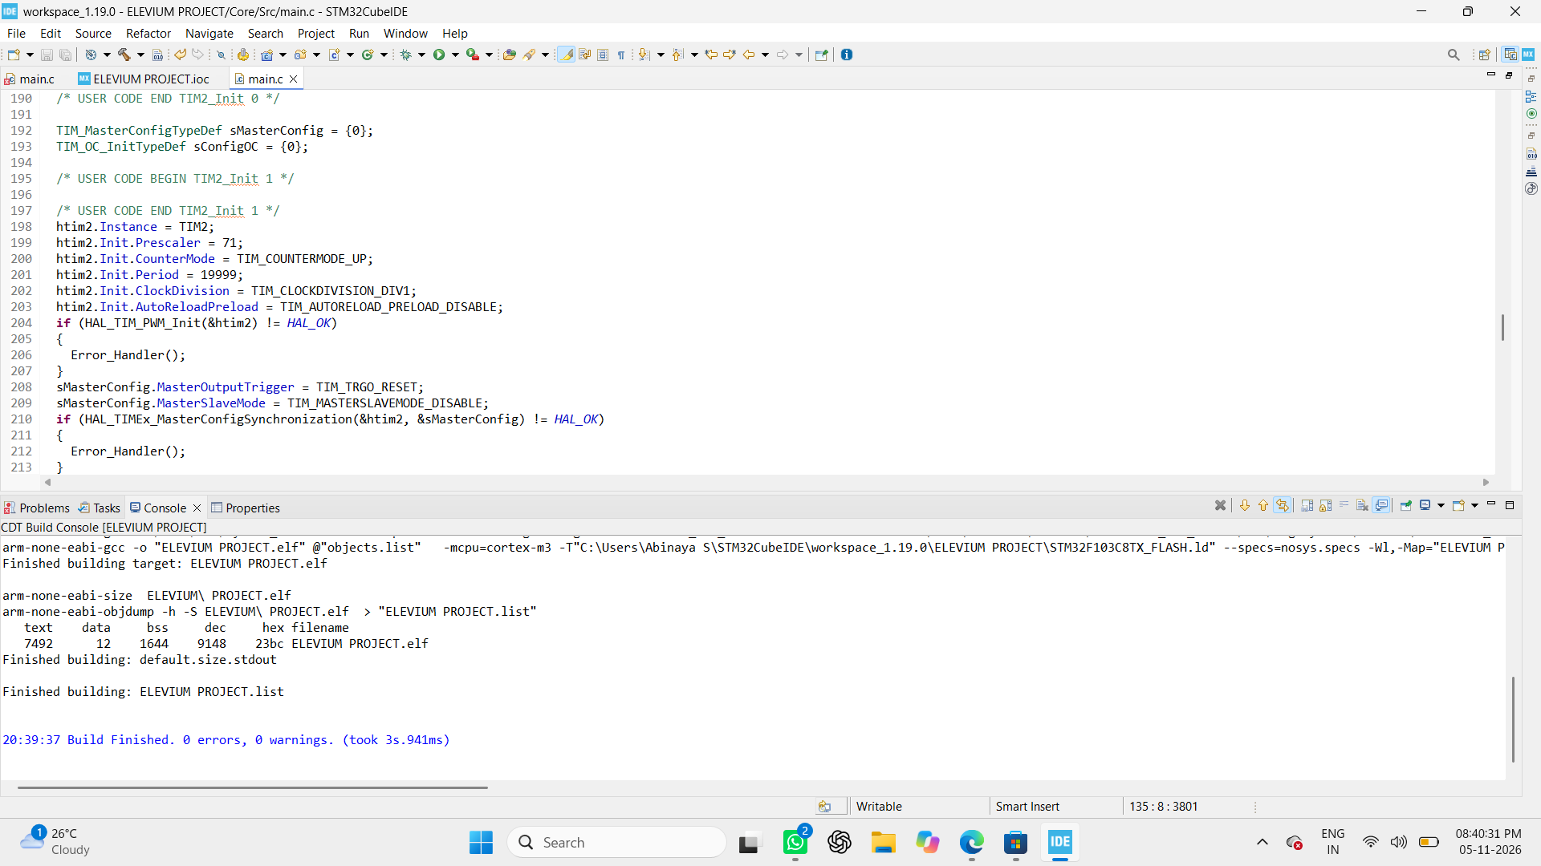
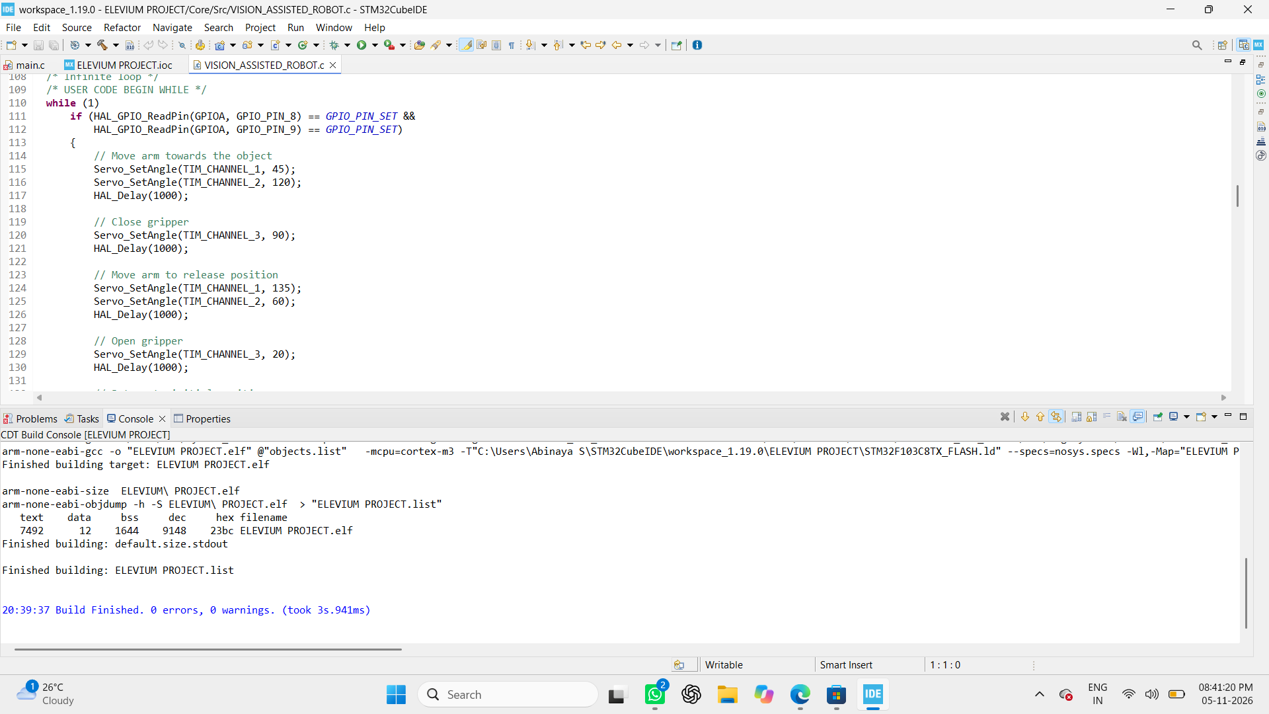
SOFTWARE:
STM32 CODE:

Slide 11
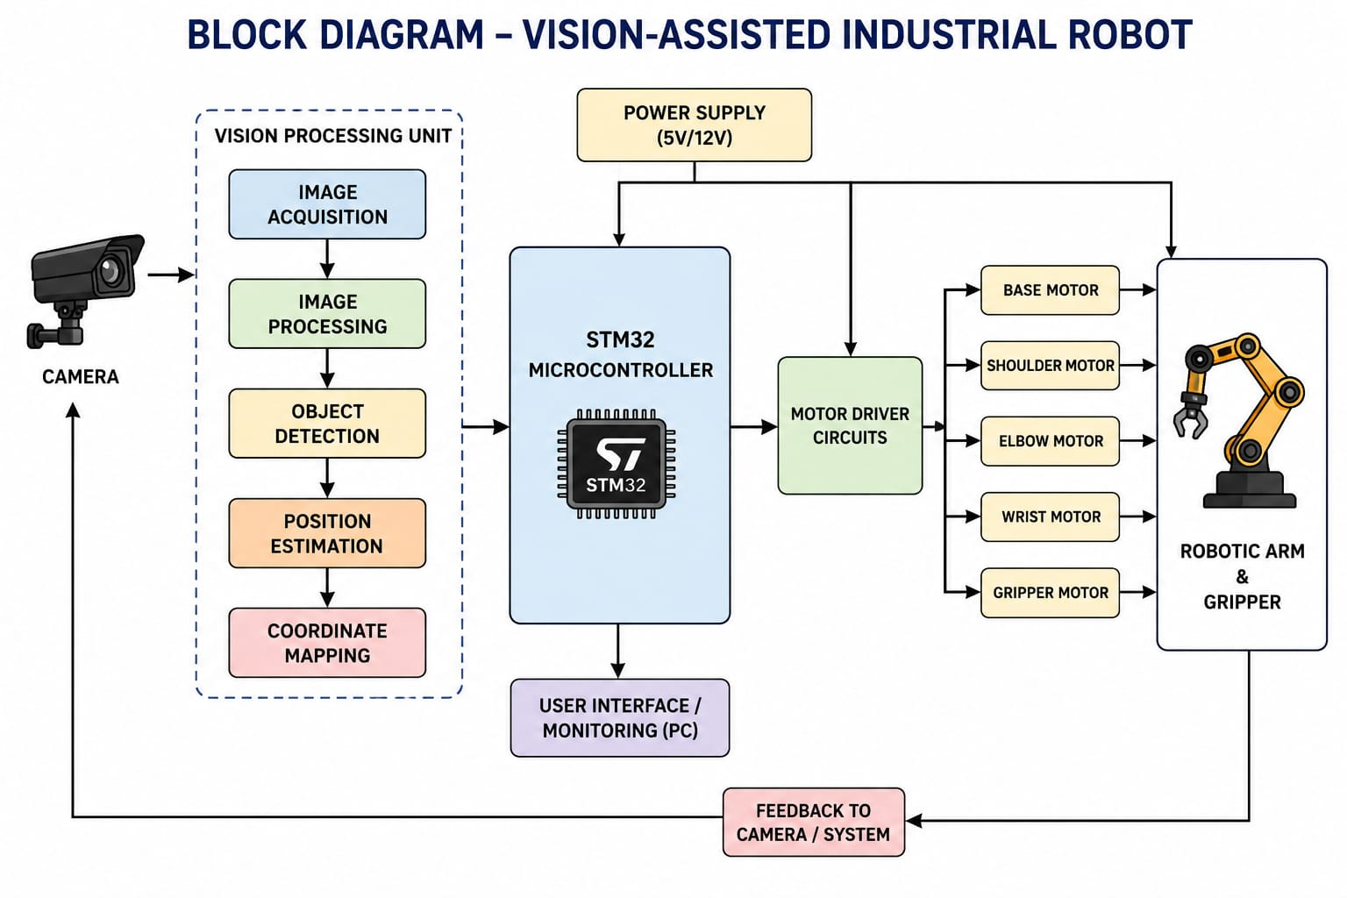

Slide 12
Applications
Industrial pick-and-place
Object sorting
Material handling
Assembly assistance
Packaging
Warehouse automation
Component handling
Small-scale manufacturing
Educational robotics

Slide 13
Expected Outcome
At the end of the project,
the prototype should be able to:
Detect → Locate → Move → Pick → Transport → Place
The expected prototype demonstrates the integration of:
Computer Vision + STM32 + Mobile Robotics + Robotic Arm
for automated object handling.

Slide 14
Conclusion
A vision-assisted mobile industrial robot can combine visual perception with embedded control.
The camera provides information about the target object.
STM32 coordinates the movement of the mobile base and robotic arm.
The prototype demonstrates automated object handling through pick-and-place.
The system provides a foundation for further development toward intelligent industrial automation.

